Slide 1
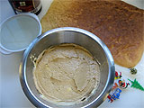
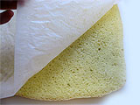
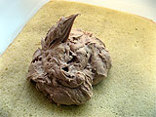
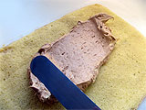
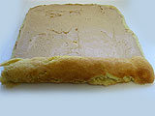
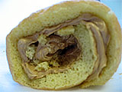
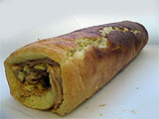
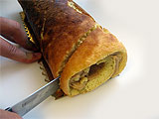
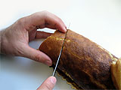
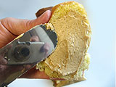
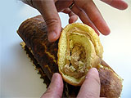
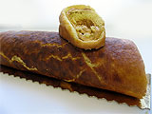
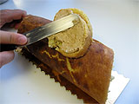
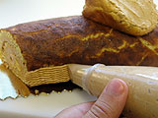
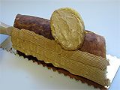
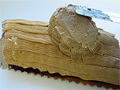
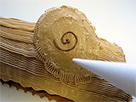
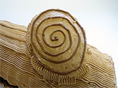
EASY bûche de noël
-- Cake --
5 Eggs separated
1 cup Powdered sugar
3 tablespoon Cocoa
-- Filling --
1 cup Whipping cream
1/4 teaspoon Vanilla
1/4 cup Powdered sugar
4 tablespoon Cocoa
-- Finishing touches – (be creative)
Chocolate frosting (You can use chocolate butter cream or any kind you want)
Candied spearmint leaves
Cinnamon candies
Peppermint candies etc…..

Slide 2
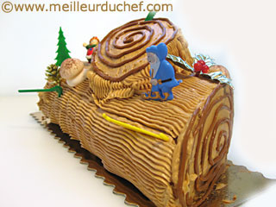
Preparations:
To make cake:
Preheat oven to 400F. Grease 15” x 10” jelly roll pan(cookie sheet). Line pan with wax paper. Crease and lour paper.
Large mixing bowl, beat egg whites with a mixer on high speed. Beat to soft peaks. Gradually beat in a cup of powdered sugar. Beat to stiff peaks. Set aside.
In a small mixing bowl beat egg yolks on low speed until thick. Beat in a cup of powdered sugar and the 3 Tbsp cocoa at high speed. Fold egg yolk mixture into egg whites. Spread in pan. Bake for 15 minutes or until top of cake springs back when touched.
Invert cake onto powdered sugar coated towel and carefully remove wax paper. Starting at the narrow end, roll towel and cake up. Place seam side down to cool (best if on a wire rack)
To make filling:
Beat all filling ingredients together. Unroll cooled cake. Spread filling on it and re-roll without the towel.
Finishing:
Ice the cake with the chocolate frosting and decorate to look like a log.
Some notes on finishing:
An end of the cake can be cut off and glued (using icing) to the side of the cake to make it look more like a log. When spreading the frosting on the cake, take some extra care to make look more log-like.
The spearmint candies are often too thick, so I slice them in half – retaining the more decorative side for the cake. The spearmint leaves together with the cinnamon candies look like holly and holly berries. I crush my peppermint candies or candy canes and sprinkle over the log. Also, you can sprinkle a light coat of powdered sugar to look like snow. Other decorative elements can be used; use your imagination!

